Slide 1
Big Data Content Analytics
Alexandra Rousi
Konstantinos Pantazis
Maria Karampela
Maria Choupa
Myrto Perati

Slide 2

Introduction
Text analytics is the process of converting unstructured text data into meaningful data for analysis
Text analytics determines key words, topics, category, semantics, tags from the millions of text data available in an organization in different files and formats
During this project we will apply Text Analytics & Neural Network techniques using TensorFlow Python library to analyze text data from news articles

Slide 3

Goal and data
The goal of this project is to:
learn user embeddings from available past articles
to use these embeddings to classify new texts to specific categories eg. Specific authors
The data that were used are a fraction of crawled news' articles from online newspapers and specifically from: "Eleftherotypia", "Rizospastis" and "Kathimerini", written by 22 different authors (size: ~250MB)
The dataset contains the following characteristics for each record per different newspaper:
Eleftherotypia: category, date, description, title, author, sources, link, keywords, aid, images, and article.
Rizospastis: aid, article, author, category, date, subcategory, link, nof_words, page, title, title2, and version.
Kathimerini: aid, article, author, category, date, subcategory, and title.

Slide 4

Tools & Methodology
Text Analytics & Neural Network techniques using TensorFlow Python library were used to reach the target of this project. TensorFlow is an open source software library for machine learning across a range of tasks
Word2vec is an algorithm for constructing vector representations of words, word embeddings. The vector for each word is a semantic description of how that word is used in context and it can be used with vector math to find words that have similar semantics.
In Deep Learning, Recurrent Neural Networks (RNN) are a family of neural networks that excel in learning from sequential data. A class of RNN that has found practical applications is Long Short-Term Memory (LSTM) because it is robust against the problems of long-term dependency

Slide 5
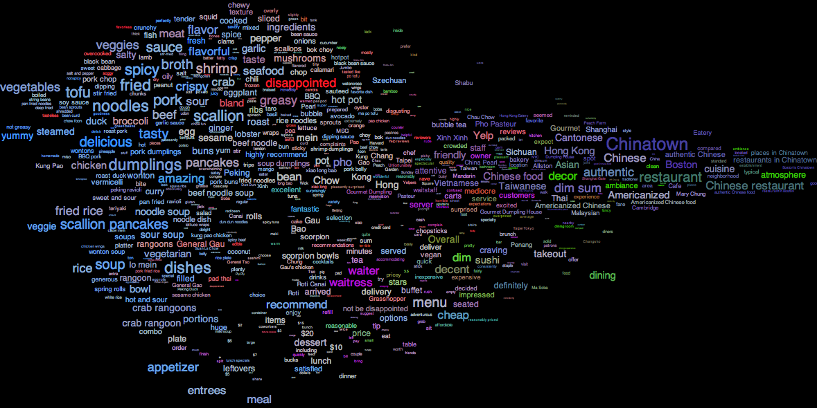
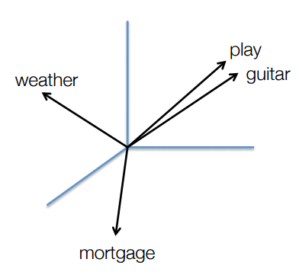
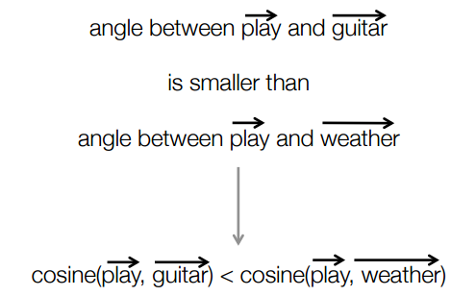
Example of word embeddings’ construction

Slide 6

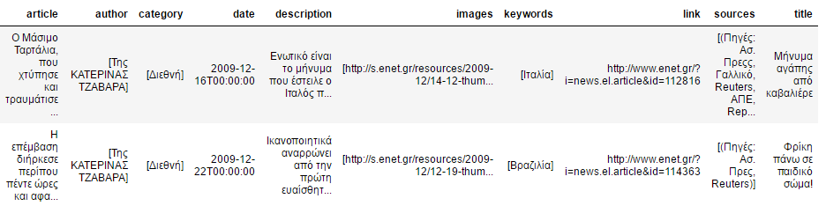
Data processing
The data were preprocessed, cleaned, evaluated and prepared for input. Some of the additional characteristics that wouldn’t add value to the model were dropped and the characteristics ‘article’ and the ‘author’ were kept. Some original records of the data are shown below:

Slide 7
Data processing
The final structure of the data is shown below:

Slide 8
Data processing
The first exploration of the data showed the following:

Slide 12
Data processing
The next step in the project’s process was to find the most commonly used words per author and to decide whether or not they are going to be kept to train the model or not
An example of the most commonly used words of Mpogiopoulos, is displayed below:
During the first parsing of the dataset common words were observed and the occurrence of these common words were considered as stopwords and were removed from corpus.

Slide 13
Model
The first model is based on word2vec implementation (author2vec). The main focus here is to learn author(user) embeddings by trying to predict the author that wrote a specific word, for all words in our corpus. By the end of the training process, the tensor of user embeddings is available as a by-product.
The Author2vec steps were the following:
Step 1: Read data (articles, author) for all newspapers from pickled files on the disk
Step 2: Tokenize article text to words using word_tokenize module from nltk package
Step 3: Build the dictionary: for each author, we keep the N most used words and we add the new words to our dictionary. Finally, we create tuples of (word_index, author_index). Author names are considered as words.
Step 5: Build and train a skip-gram model
Step 6: Begin training. With a num_steps = 74001 (4 epochs having embedding size 200) we perform one update step by evaluating the optimizer op
Step 7: Finally we visualize the produced embeddings using tSNE

Slide 14

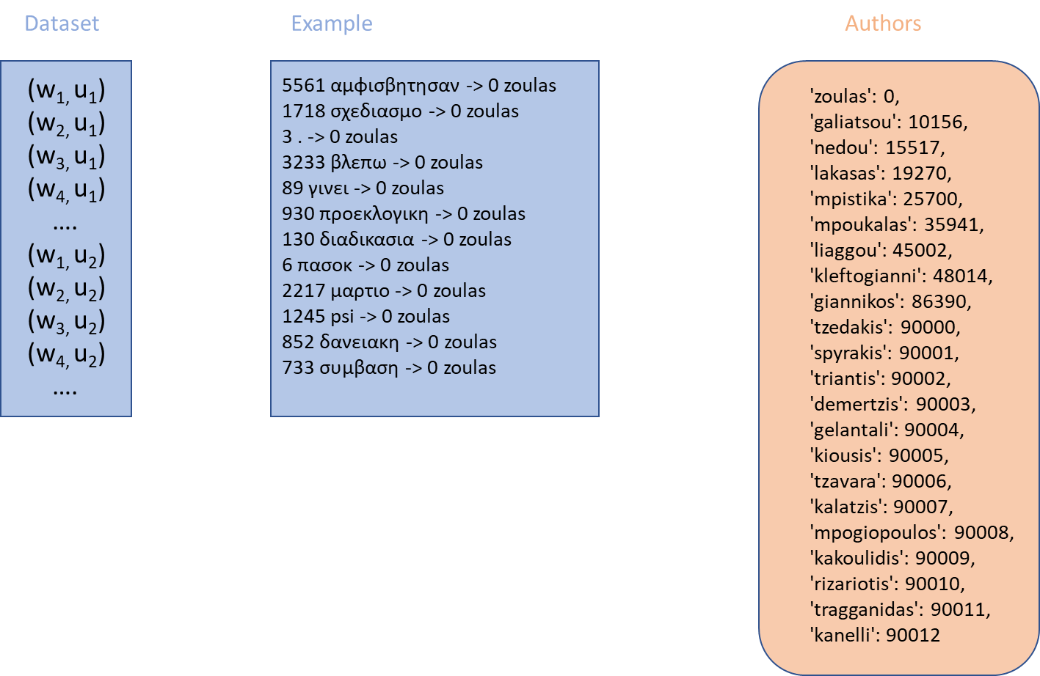
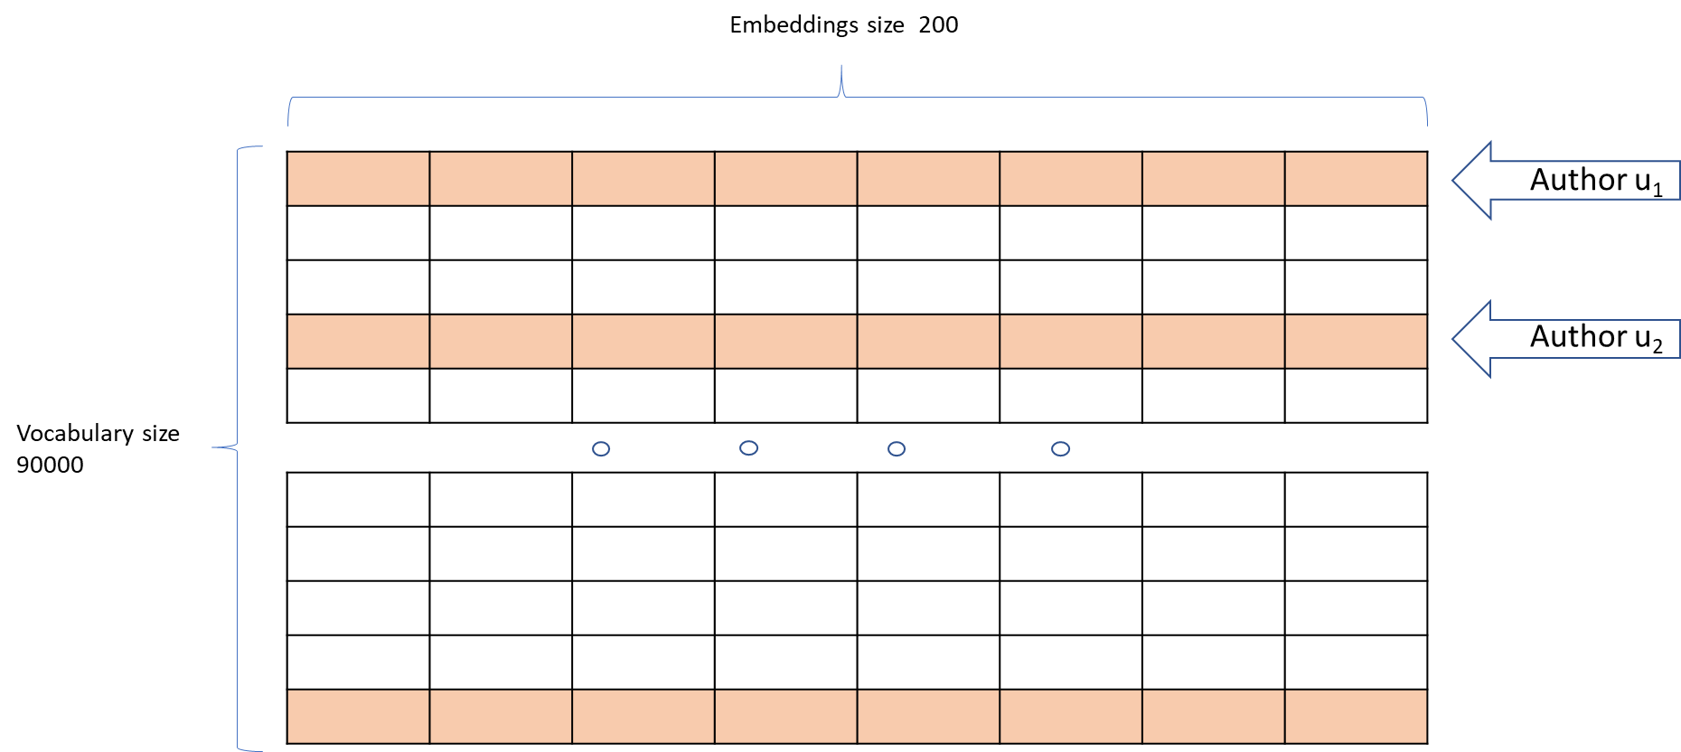
Dataset / method
Example of dataset and the embeddings tensor:

Slide 15
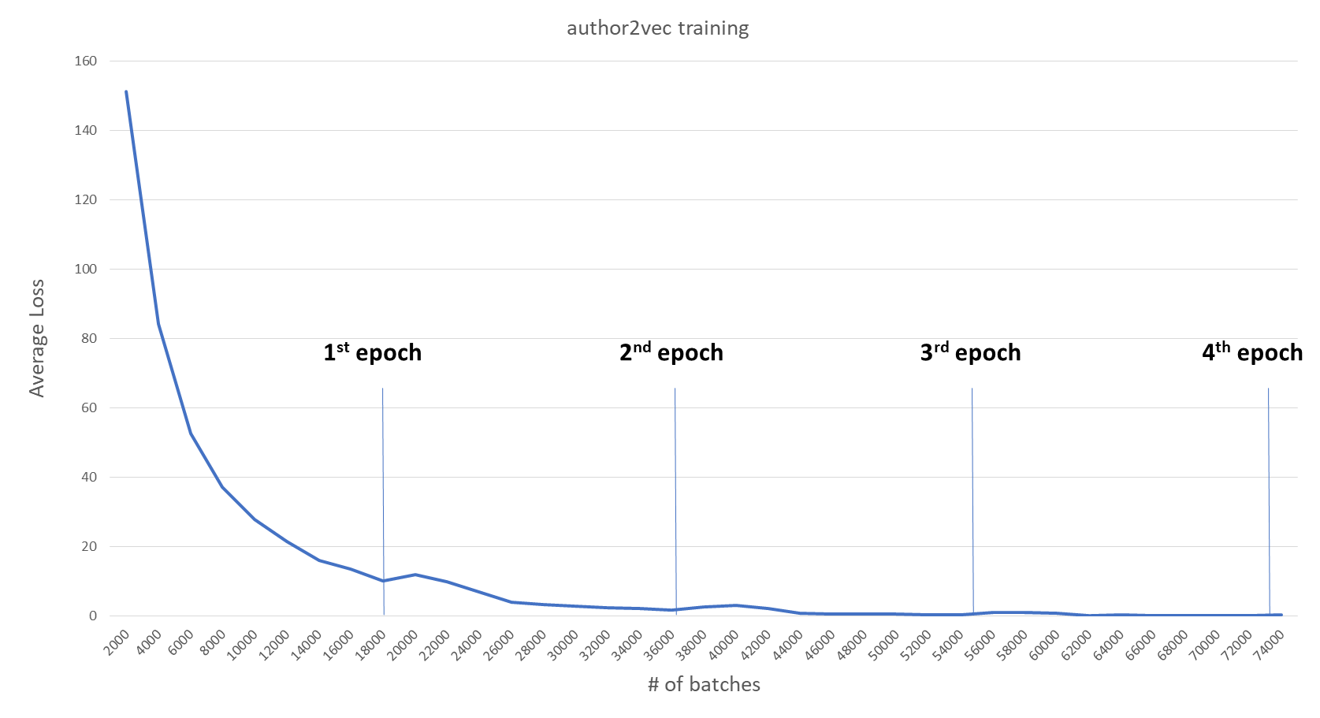
Results
A word vocabulary of 90.000 words was created. The embedding vector size was set to 200. After processing, the dataset contained 3.697.025 tuples (word, author)
The following output shows the training process for 74.000 steps / 4 epochs

Slide 16
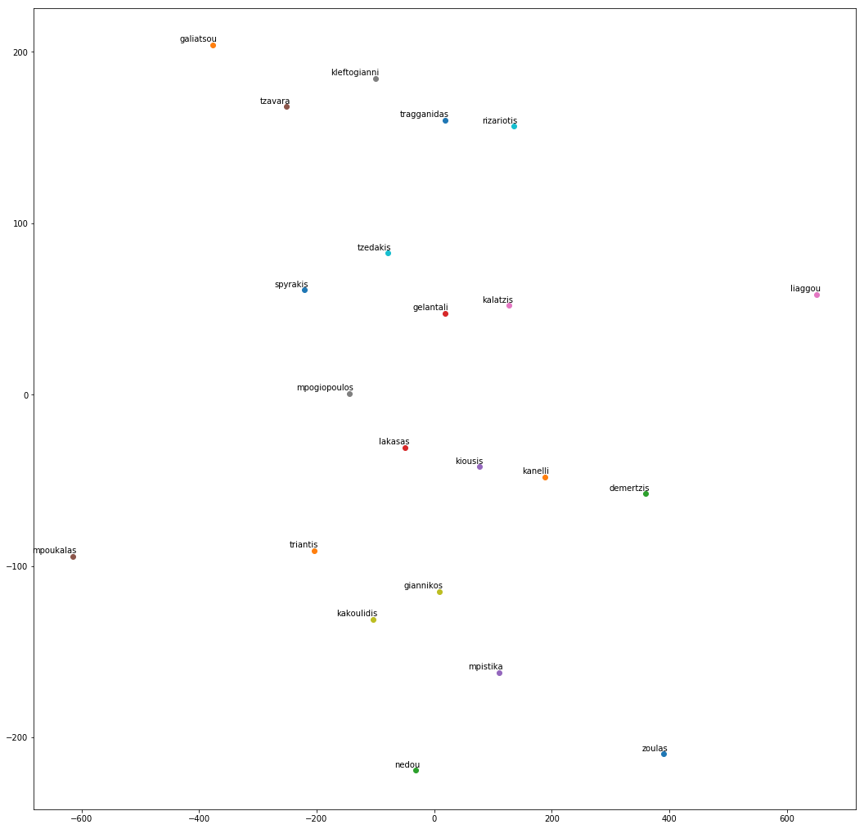
Final result
The visual representation of the learned embeddings is showed on the right
It should be studied further to show whether it succeeds in capturing the authoring style of our authors under test

Slide 17
Future work
More NN techniques (RNN/LSTM, …) and libraries/frameworks should be tested (keras, gensim, glove)
Word stemming would help in dramatical reduction of vocabulary size, allowing more words to be included in training.
n-grams can be considered instead of single word samples
After having successfully learned author embeddings:
Predict the next words of a new text, having identified the authoring style
Identify topics of interest for each author

Slide 18


